Slide 1
Microservices and DevOps
Scalable Microservices
Humio
Henrik Bærbak Christensen

Slide 2
Intro
Humio = Lots of manual machinery!
When you find it taxing – remember…
This is nothing compared to an ELK stack ☺
I spend vast number of hours on ELK and it was tedious and required a lot of CPU power ☹

Slide 3
Setup
We go for their Community Edition Cloud Service…

Slide 4
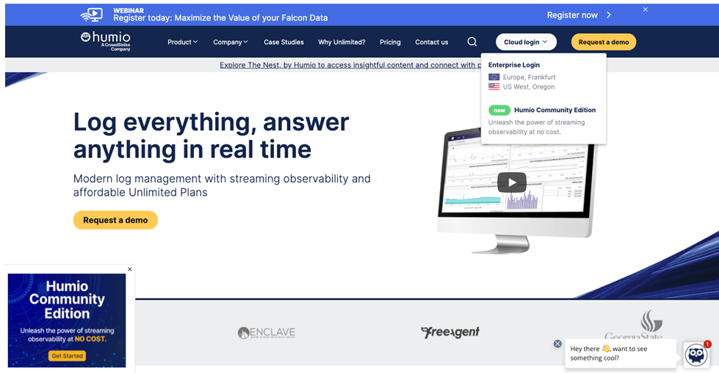
Just Click…

Slide 5
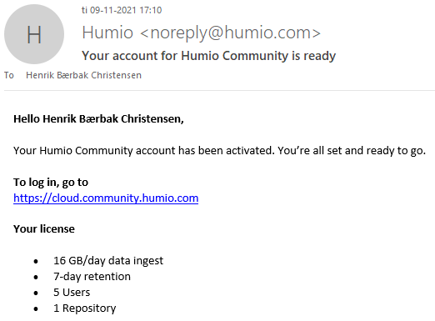
You will need to register…
And some time (1-2 days – or just a few hours) later, you get access…

Slide 6
Next Steps – In Overview
You need to
Define a repository
to hold your logging data
Define an ingest token
That identifies where your log stream’s sink is
That is – the repository
Define a parser
So Humio can understand the format of your log messages
Make your container(s) ship logs to your repository

Slide 7
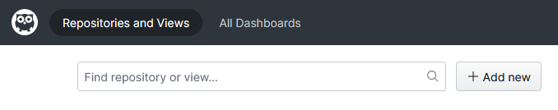
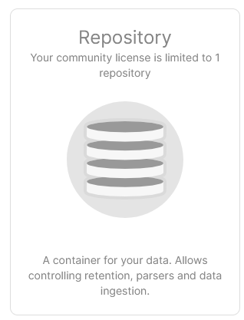
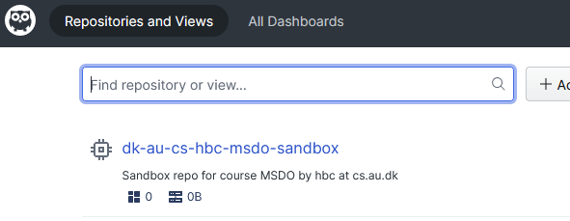
Define Repo
Add repo
Hit ‘Repository’ and define one with a unique name

Slide 8
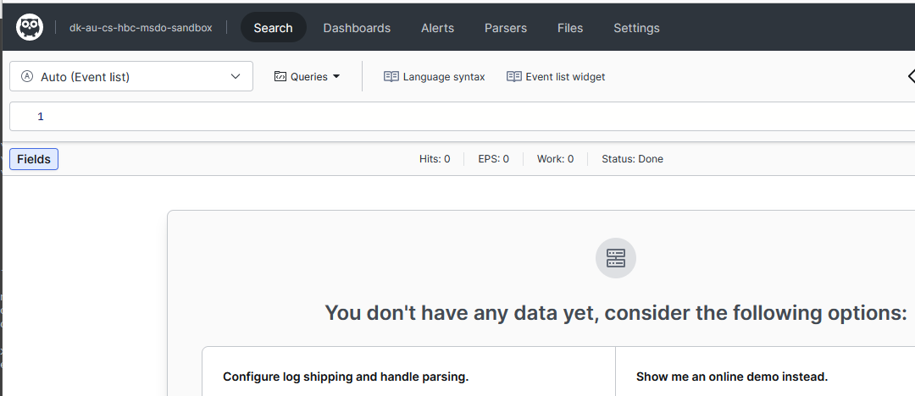
Define Token
Hit your defined repo to find the dashboard page

Slide 9
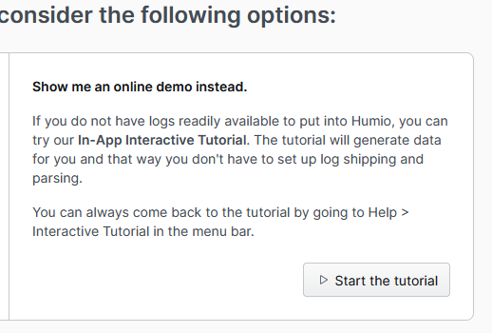
Do the Tutorial
Advice to browse over the tutorial
One of the super great assets of Humio – is the built-in learning experience !

Slide 10
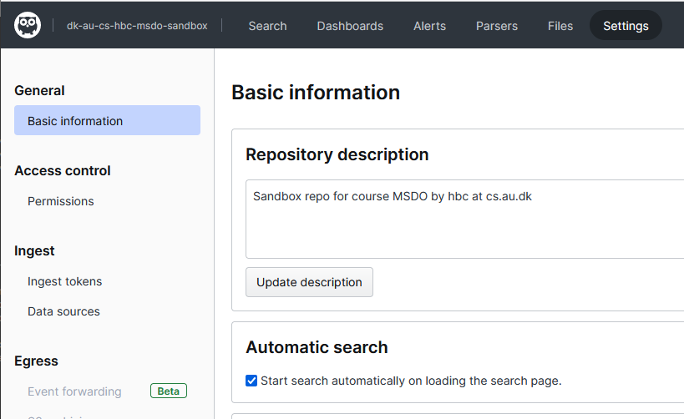
… and now define Ingest Token

Slide 11
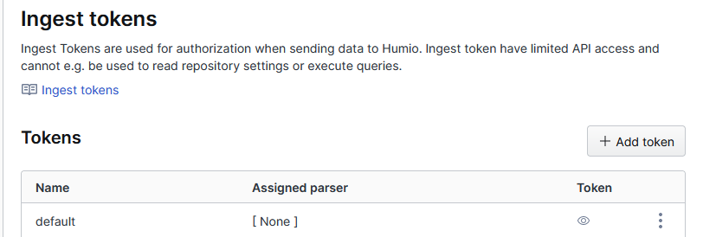
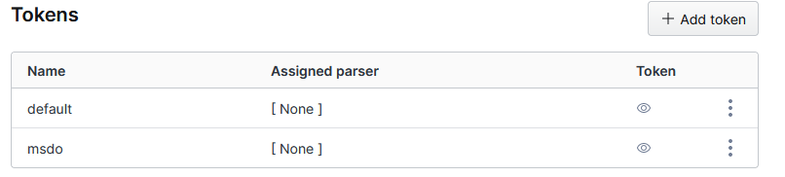
… ingest token
Use ‘eye’ to get the token

Slide 12
Logging to Humio
Now, the next (big) challenge is
Telling Docker to forward logs to Humio
Make Humio understand the weird ‘Henrik Bærbak’ logging format
Understand what we can do with Humio…

Slide 13
Docker Forwarding
Fortunately, Humio support in Docker is already built-in
Just use the ‘splunk’ logging driver of Docker
Tell Docker to use splunk, not the default logging driver
Tell Docker which machine to ship the logs to
Tell Docker the proper credentials (INGEST_TOKEN)

Slide 14
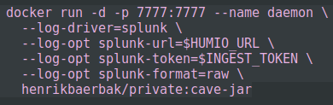
Ingest Token
The token must be provided for any docker run. One way:
export INGEST_TOKEN=(paste token here)
Now, start your daemon with the proper settings
Set driver
Set endpoint URL
Humio’s endpoint
Set ingest token
Set format to ‘raw’
Makes parsing easier…

Slide 15
Let’s see some action

Slide 16
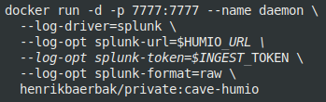
I did…
… these steps
Build an image
Set the Humio environment
Run the daemon

Slide 17
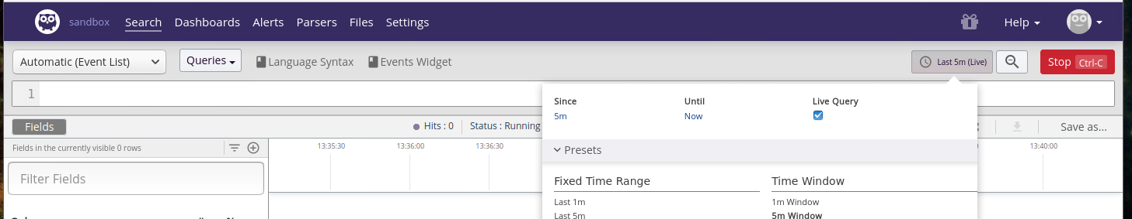
Testing
You should see some log messages coming in…
… if you set the search for 5 minutes / live
And hit the ‘run’ button

Slide 18
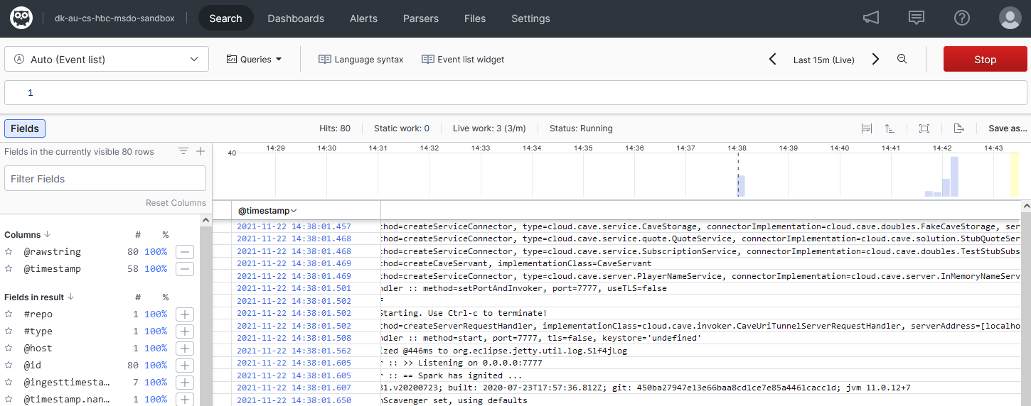
Example

Slide 19
But – No Parsing
Humio understands most common logging formats
Accesslog, syslog, json, key-value
However, our Log4J property file defines its own
Why? Well…
What is the problem?
We cannot make queries as each log is just a raw string ☹

Slide 20
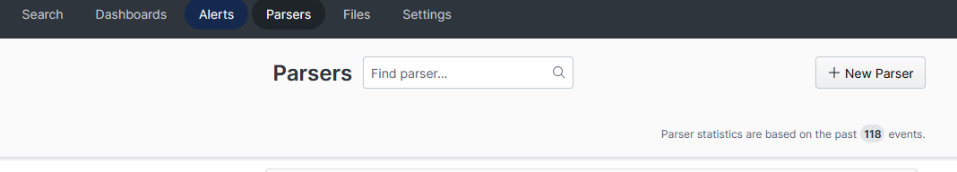
A Parser
You will need to define a new parser

Slide 21
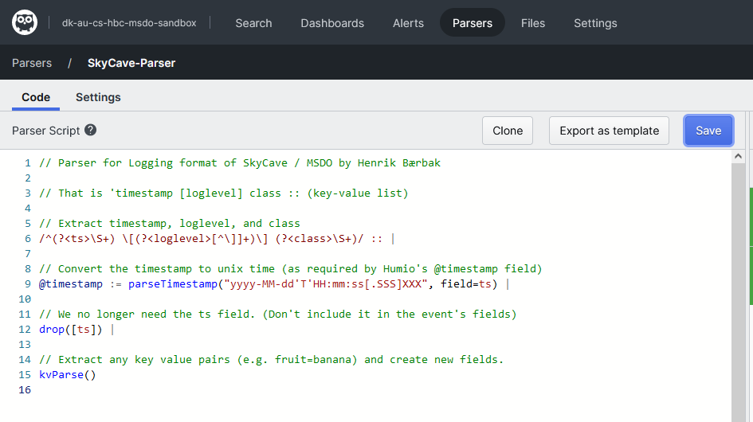
A Parser
And as my format is (mostly) a key-value based one, enter:
Find the file on the weekplan !

Slide 22
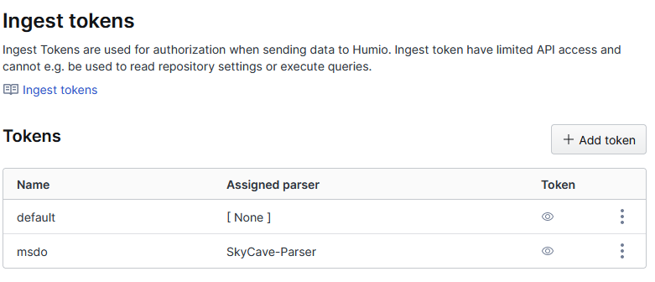
And associate it…
With your token

Slide 23
Unfortunately!
The most interesting log message is about the daemon accepting and replying to the ‘cmd’ requests
The log message stems from the FRDS.Broker library, which unfortunately has the interesting stuff encoded in a json object ☹
I have not been able to create a parser that can handle that format (would love if someone cracked that nut!)
Even if Humio states I can: “kvParse() | parseJson(field=reply)”
I just get ‘reply=payload’ ???

Slide 24
So, to monitor commands…
We have to augment the CaveInvoker’s and PlayerInvoker’s handleRequest()
Find updated code on the weekplan.

Slide 25
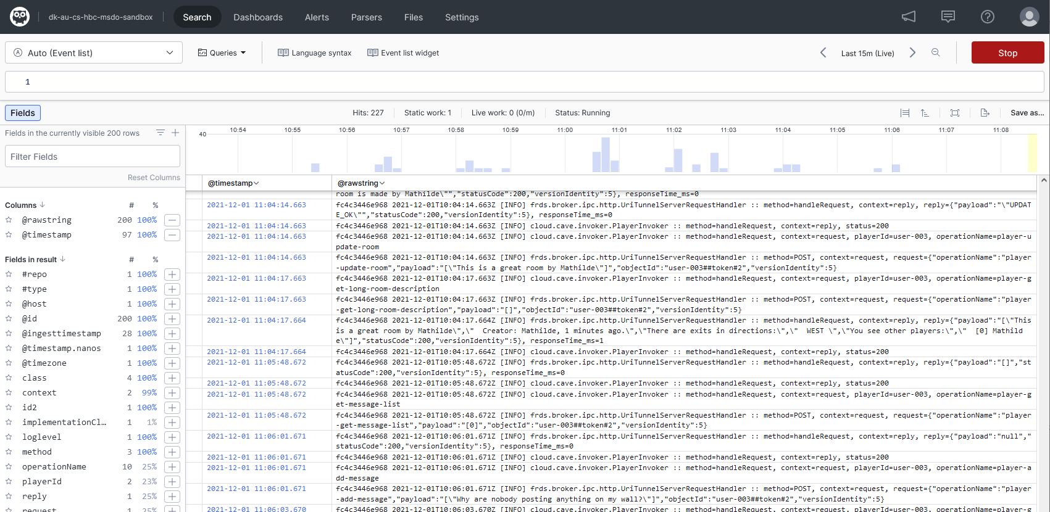
In Action
Meta: gradle cmd –Pcpf=malkia.cpf
Notes:
Internal note: I made a http.cpf configured SkyCave run on malkia.st.lab.au.dk. Be on VPN to make it work.

Slide 26
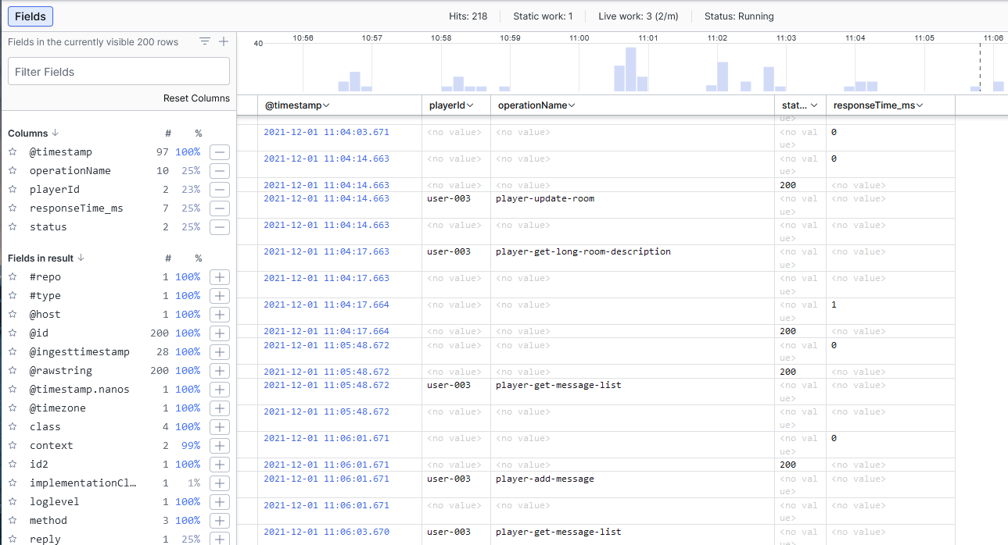
Selecting Columns

Slide 27
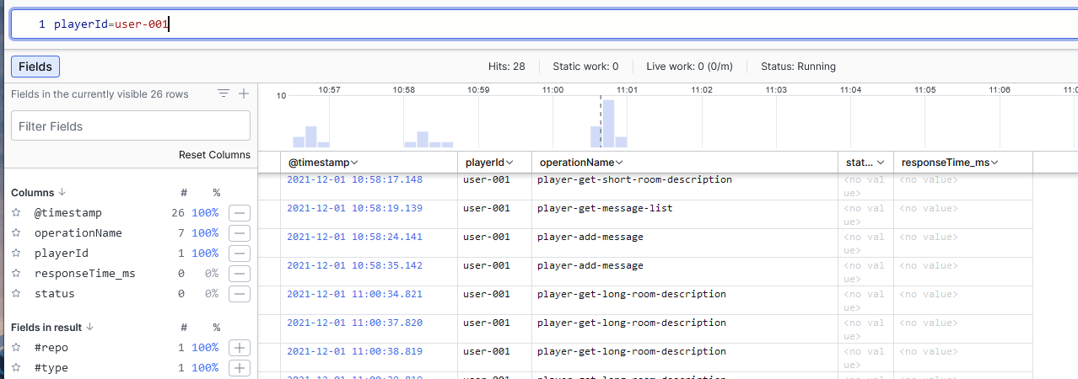
Query
You can use a query language
Do the tutorial ☺

Slide 28
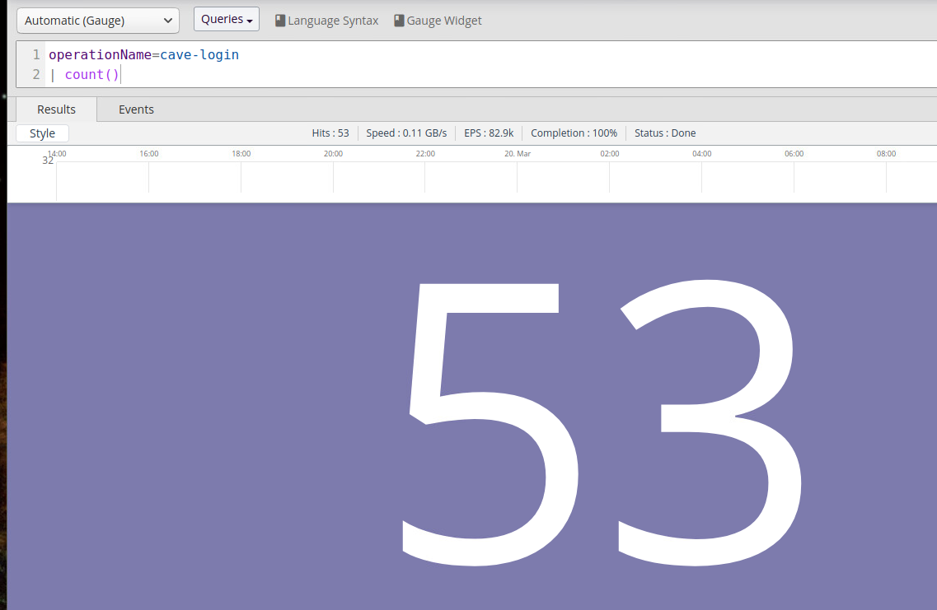
Semi SQL like ☺

Slide 29
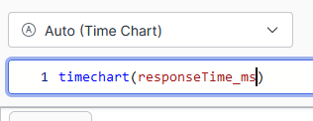
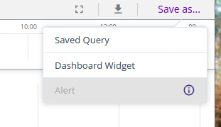
Dashboards
Perform a search
Hit ‘Save as…’
And add to a dashboard

Slide 30
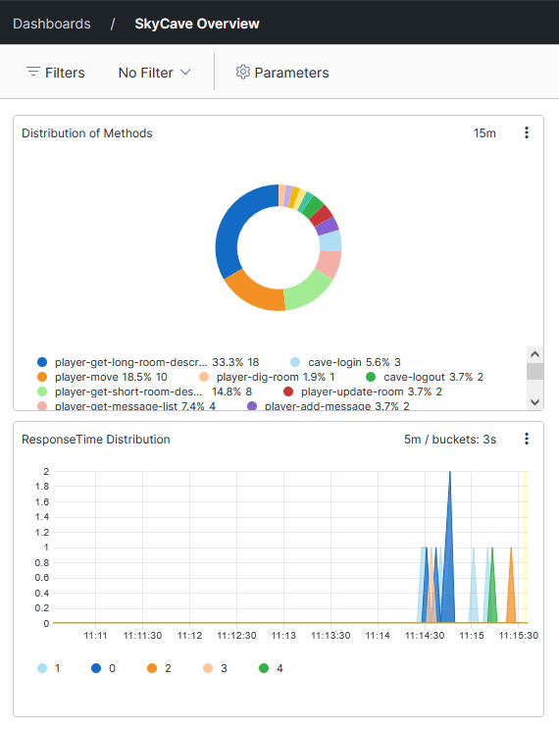
Dashboard Example
Here I have added two widgets
Distribution of Methods
Query: operationName=* | groupBy(operationName)
As Pie Chart
Response time distribution
As TimeChart

Slide 31
Swarm
More fiddling ☹

Slide 32
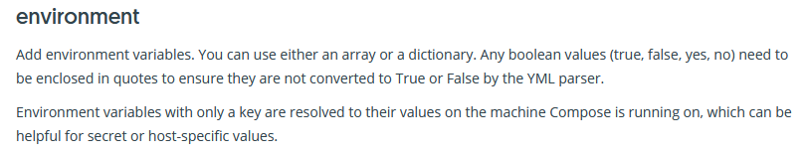
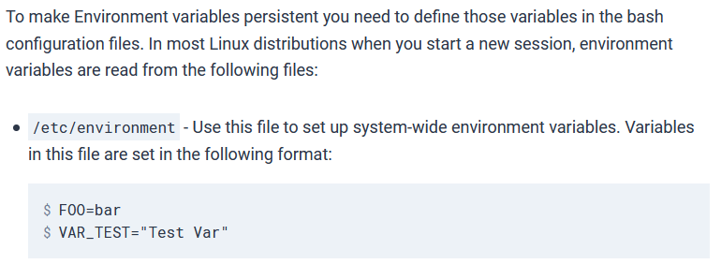
The IngestToken
Easy to use an environment variable on a single node
For swarm it is a bit more tricky:
Alas, you have to set it on each machine in swarm ☹
Fiddling ☹

Slide 33
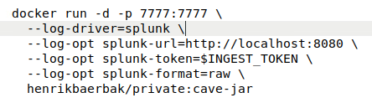

And the compose-file
… and then you have to adopt your compose file to set the same properties as for the ‘docker run’ but now in YAML format…
Jobs done…
Alternative:
Expose your ingest token directly in the compose file. Hm hm…
And more ☺

Slide 34
Summary
Log aggregation is a powerful tool
Humio has a (comparable) gentle learning curve
Quite a lot of moving parts still ☺…

